Slide 1
JAVA
Unit 5(b)

Slide 2
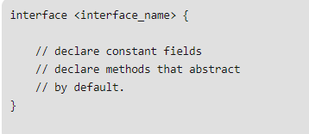
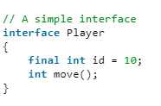
Interface declaration

Slide 3
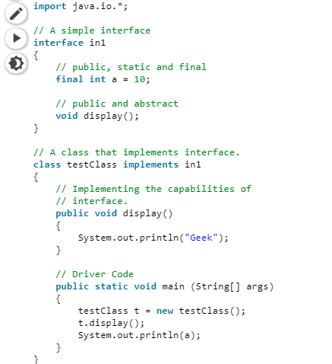
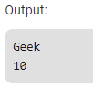
Interface implementation

Slide 4
Nested Interface
https://www.geeksforgeeks.org/interface-nested-class-another-interface/
Note: Nested interface must be public if it is declared inside the interface but it can have any access modifier if declared within the class.

Slide 5
Default interface methods
Before Java 8, interfaces could have only abstract methods. The implementation of these methods has to be provided in a separate class. So, if a new method is to be added in an interface, then its implementation code has to be provided in the class implementing the same interface.
To overcome this issue, Java 8 has introduced the concept of default methods which allow the interfaces to have methods with implementation without affecting the classes that implement the interface.

Slide 6
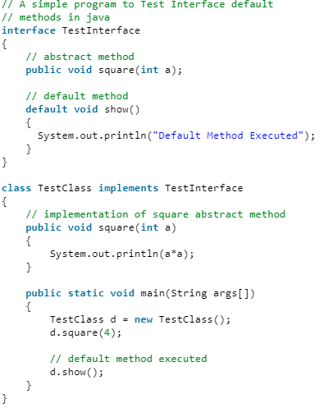
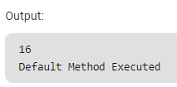
Default interface methods

